Slide 1
Capitalizing on New Opportunities for Systemic Improvement in Mathematics Education
Diane J. Briars
President
National Council of Teachers of Mathematics
dbriars@nctm.org
April 14, 2016

Slide 2
FYI
Electronic copies of slides are available
by request
dbriars@nctm.org
and posted at
nctm.org/briars

Slide 3
Agenda
New developments/reports about mathematics curriculum, teaching and learning.
Implications for K-12 mathematics education
Actions for moving forward

Slide 4
College and Career Readiness
Business and political leaders are asking schools to ensure that students leave high school “college and career ready”, possessing 21st century competencies that will prepare them for adult roles as citizens, employees, managers, parents, volunteers and entrepreneurs.
How do you define 21st century competencies?

Slide 5
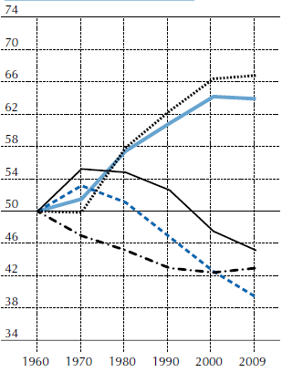
Trends in the Demand for Skills in the US
Average change in task inputs across education-industry cells, in percentiles of the 1960 task distribution

Slide 6
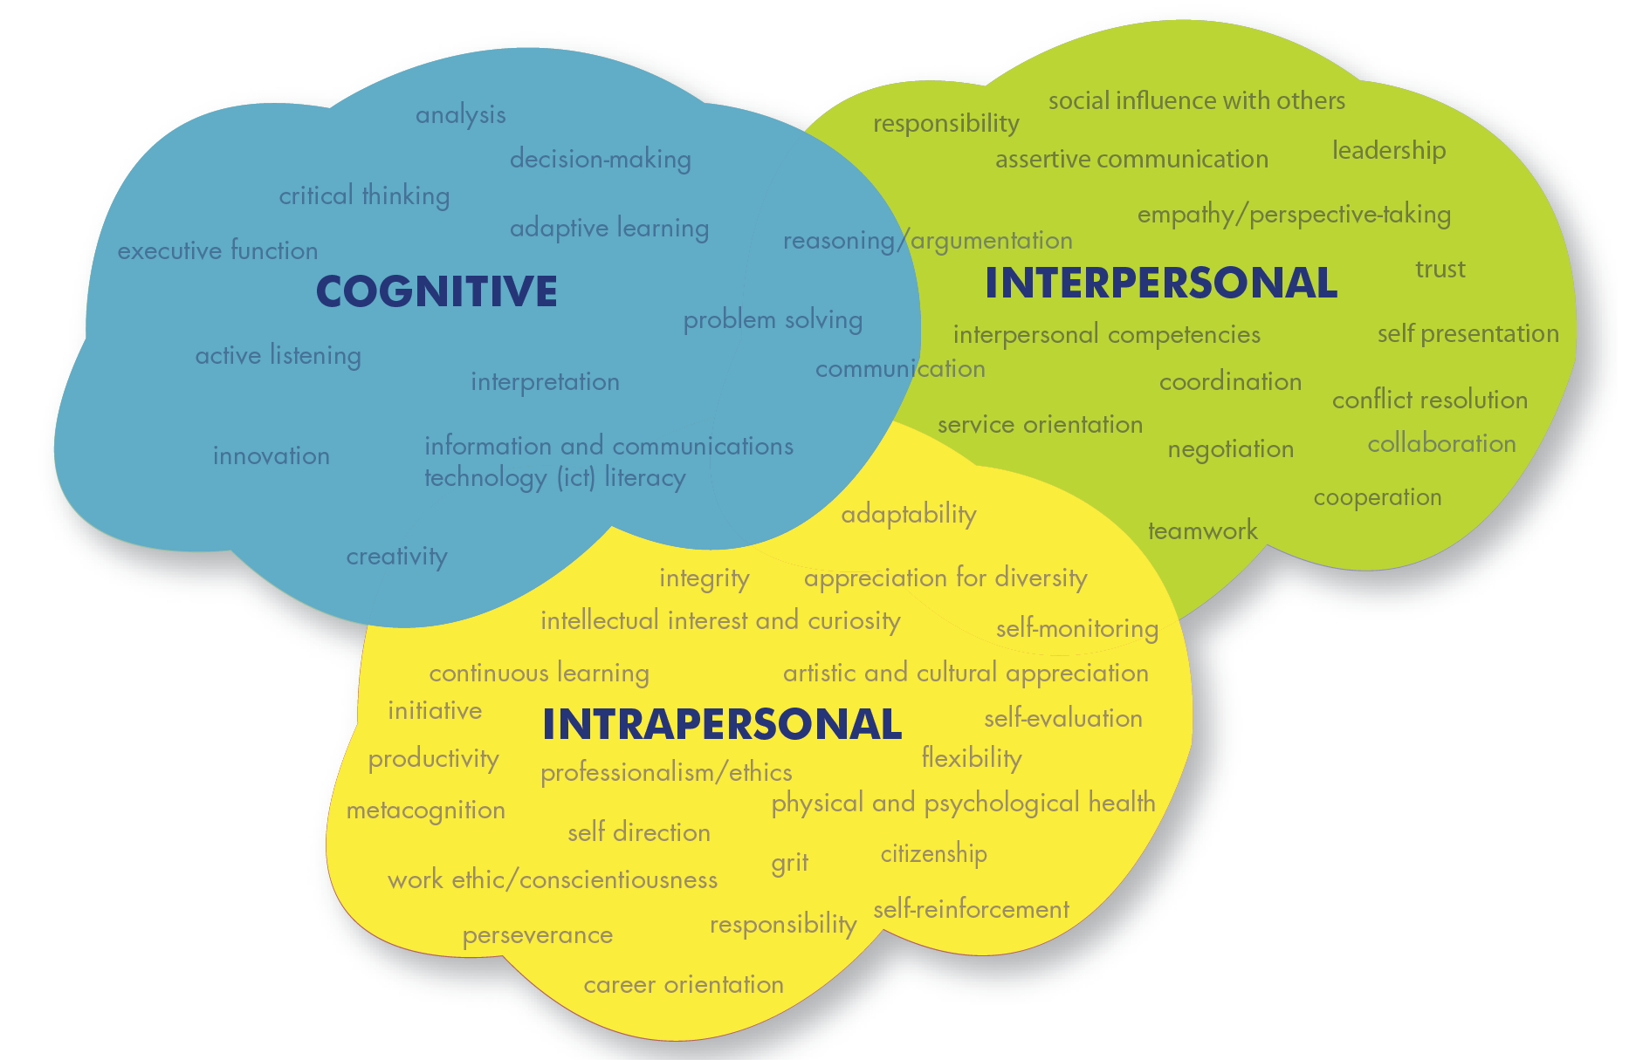
21st Century Competencies
Education for Life & Work, NRC 2012

Slide 7
21st Century Competencies
Cognitive domain
Thinking, reasoning, and related skills
Intrapersonal domain
Self management, including regulating one’s behavior and emotions to reach goals;
Interpersonal domain
Expressing information to others, as well as interpreting others’ messages and responding appropriately.
Education for Life & Work; Guide for Practitioners, p. 4

Slide 8
21st Century Competencies
“Deeper learning” is the process through which an individual becomes capable of taking what was learned in one situation and applying it to new situations (i.e., transfer). . . . The product of deeper learning is transferable knowledge, including content knowledge in a domain and knowledge of how, why, and when to apply this knowledge to answer questions and solve problems. We refer to this blend of both knowledge and skills as “21st century competencies.”
Education for Life & Work, p. 5

Slide 9
Standards for Mathematical Practice
Make sense of problems and persevere in solving them.
Reason abstractly and quantitatively.
Construct viable arguments and critique the reasoning of others.
Model with mathematics.
Use appropriate tools strategically.
Attend to precision.
Look for and make use of structure.
Look for and express regularity in repeated reasoning.

Slide 10
McDonald’s Claim
Wikipedia reports that 8% of all Americans eat at McDonald’s every day.
320 million Americans and 14,350 McDonald’s…
Could the Wikipedia report be true?
Create a mathematical argument to justify your position.
If you believe the claim is not true, determine a reasonable percentage.

Slide 11
McDonald’s Claim
Calculations:
8% of 320 million people/day = 25.6 million people/day
25.6 million people ÷ 14,350 McDonald’s = 1,784 people/McDonald’s/day ≈ 2,000 people/McDonald’s/day
Discussion: Assumptions/Definitions
What does it mean to “eat at”?
What does “8% .. eat at everyday”?
# of hours a typical McDonald’s is open each day
# of registers, # of drive-thru lanes
Americans eating in McDonald’s outside of the US?

Slide 12
McDonald’s Claim Problem
What mathematics content is needed to complete the task?
Which mathematical practices are needed to complete the task?

Slide 13
Standards for Mathematical Practice
Make sense of problems and persevere in solving them.
Reason abstractly and quantitatively.
Construct viable arguments and critique the reasoning of others.
Model with mathematics.
Use appropriate tools strategically.
Attend to precision.
Look for and make use of structure.
Look for and express regularity in repeated reasoning.

Slide 14
Standards for Mathematical Practice
SMP 4: Model with Mathematics
Make assumptions and approximations to simplify a complicated situation
Identify important quantities in a practical situation
Analyze relationships mathematically to draw conclusions
Interpret their mathematical results in the context of the situation
Reflect on whether the results make sense.
SMP 3. Construct viable arguments and critique the reasoning of others
Make conjectures
Justify their conclusions and communicate them to others
Recognize and use counterexamples
Compare the effectiveness of two plausible arguments
Listen and respond to the arguments of others for sense making and clarity

Slide 15
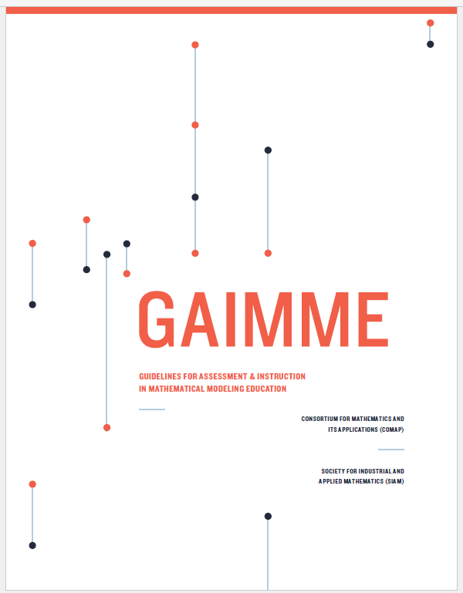
Guidelines for Assessment and Instruction in Mathematical Modeling Education (GAIMME)
What is mathematical modeling?
What does it look like in pK-8, high school, and college?
Appendices with resources and examples

Slide 16
What is Mathematical Modeling?
Mathematical modeling is a process that uses mathematics to represent, analyze, make predictions or otherwise provide insight into real-world phenomena.

Slide 17
What is Mathematical Modeling?
Mathematical modeling is a process made up of the following components:
Identify the problem
Make assumptions and identify variables
Do the math
Analyze and assess the solution
Iterate
Implement the model

Slide 18
CCSS Modeling Cycle

Slide 19
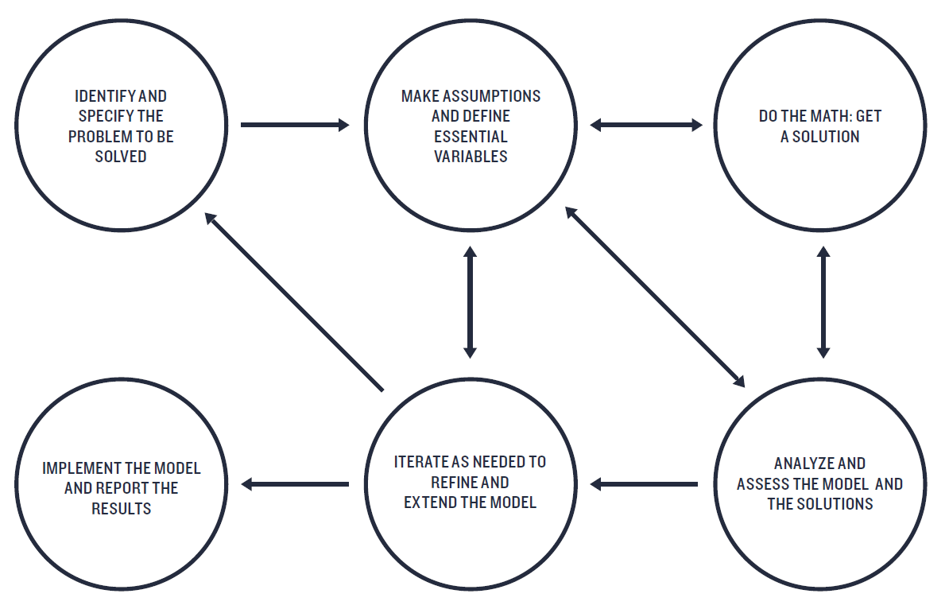
GAIMME Modeling Cycle

Slide 20
Guidelines for Assessment and Instruction in Mathematical Modeling Education (GAIMME)
Math Problems
Word Problems
Application
Problems
Mathematical Modeling
Problems
Source: Garfunkel, Sol, et al. (Ed.). Guidelines for Assessment and Instruction in Mathematical
Modeling Education. Boston/Philadelphia: Consortium for Mathematics and its Applications/
Society for Industrial and Applied Mathematics, 2016.

Slide 21
Example: Driving for Gas
You drive 12.3 miles to get to work each day and gas costs $3.00 a gallon. How much do you spend on gas each day? If you shared the cost with someone else by carpooling, how many days would you have to carpool to reduce your cost by 1/3?
Word Problem
Source: NCTM/SIAM Joint Committee on Mathematical Modeling Across the Curriculum

Slide 22
Example: Driving for Gas
Suppose there is a station on your normal route that sells gas for $3.00 a gallon. A station 5 miles off your route sells gas for $2.85 a gallon. Should you drive the extra distance to buy gas at that station?
Application Problem
Source: NCTM/SIAM Joint Committee on Mathematical Modeling Across the Curriculum

Slide 23
Example: Driving for Gas
You drive to school every day. On the route you take from home to school, there are several gas stations. Unfortunately, the prices on your route are always high. A friend tells you she buys her gas at a station several miles off your normal route where the prices are cheaper. Would it be more economical for you to drive the extra distance for the less expensive gas than to purchase gas along your route?
Mathematical Modeling Problem
Source: NCTM/SIAM Joint Committee on Mathematical Modeling Across the Curriculum

Slide 24
Where Does the McDonald’s Claim Problem Fit in this Continuum?
Math Problems
Word Problems
Application
Problems
Mathematical Modeling
Problems
Source: Garfunkel, Sol, et al. (Ed.). Guidelines for Assessment and Instruction in Mathematical
Modeling Education. Boston/Philadelphia: Consortium for Mathematics and its Applications/
Society for Industrial and Applied Mathematics, 2016.

Slide 25
SMP 4: Model with Mathematics
Make assumptions and approximations to simplify a complicated situation
Identify important quantities in a practical situation
Analyze relationships mathematically to draw conclusions
Interpret their mathematical results in the context of the situation
Reflect on whether the results make sense.

Slide 26
GAIMME Modeling Cycle

Slide 28
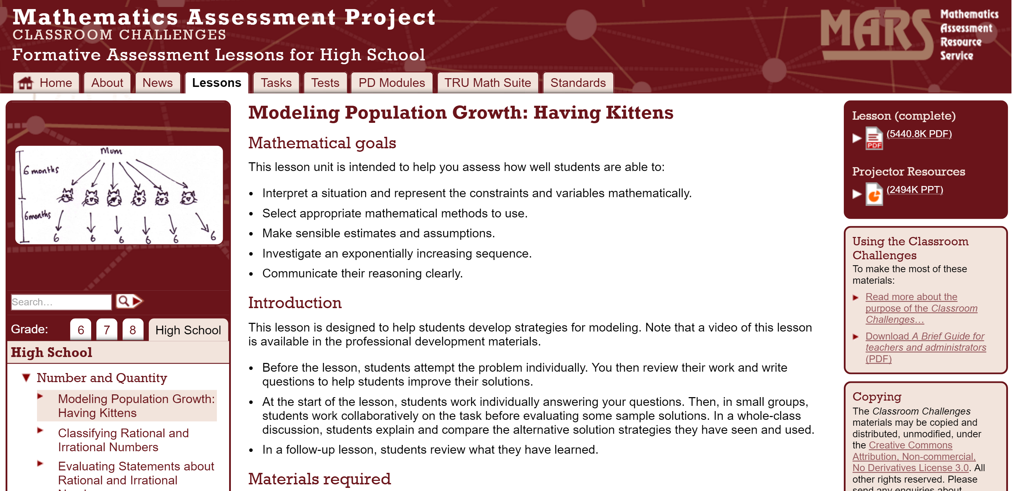
http://map.mathshell.org/

Slide 29
NCTM GAIMME Sessions
106- What Is the Current State of Mathematical Modeling Education?
Thursday, April 14, 2016: 9:45 AM-11:00 a.m., 306 (Moscone)
251- GAIMME: Mathematical Modeling for Elementary School
Thursday, April 14, 2016: 3:30 PM-4:30 p.m., 305 (Moscone)
274- GAIMME: Mathematical Modeling for Middle School
Friday, April 15, 2016: 8:00 AM-9:00 a.m., 305 (Moscone)
403- GAIMME: Mathematical Modeling for High School
Friday, April 15, 2016: 12:30 PM-1:30 p.m., 305 (Moscone)

Slide 30
College and Career Readiness
Examines the mathematical science now and how it needs to evolve to produce the best value for the country by 2025.
Describes the remarkable success of the mathematical sciences in the opening years of the 21st century.
Highlights the increasing importance of statistics, modeling and discrete mathematics.

Slide 31
College and Career Readiness
Our high schools focus on getting people prepared for calculus . . .
But we do little to teach statistics, probability, and uncertainty . . .
This is one of the biggest issues facing U.S. mathematical sciences; it is also a big problem in terms of national competitiveness.

Slide 32
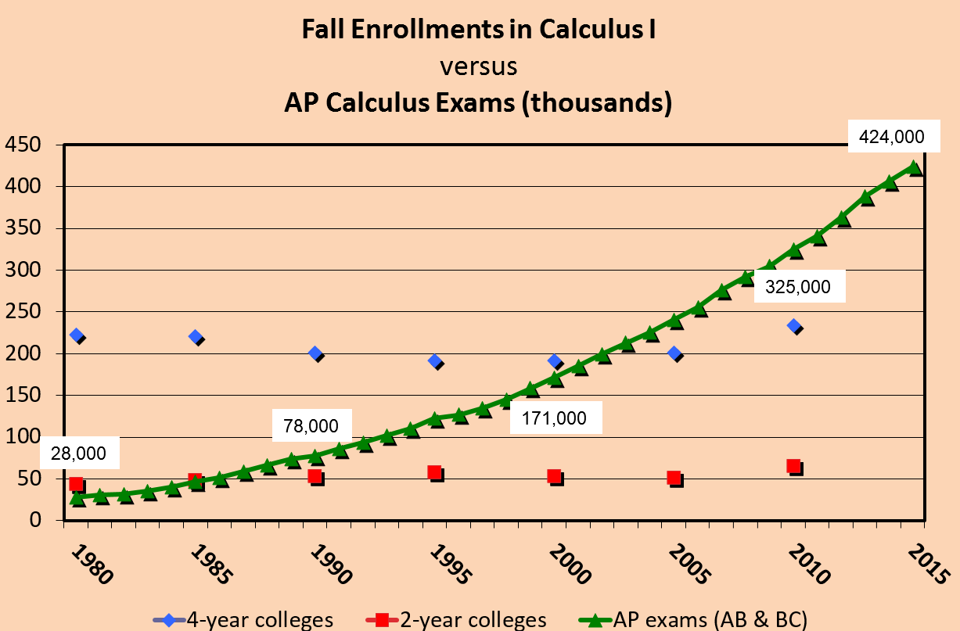
The Rush to Calculus
Sources: CBMS and College Board

Slide 33
A Common Vision for Undergraduate Mathematical Sciences in 2025
“The status quo is unacceptable.”
Calls on the community to:
Update curricula
Articulate clear pathways between curricula driven by changes in K-12 and the first courses students take in college
Scale up the use of evidence-based pedagogical methods

Slide 34
Active Learning Increases Student Performance in Science, Engineering, and Mathematics
Meta-analysis of 225 studies comparing student performance in undergraduate science, technology, engineering, and mathematics (44 studies) (STEM) courses under traditional lecturing versus active learning.
Active learning interventions included:
occasional group problem-solving,
worksheets or tutorials completed during class,
use of personal response systems
studio or workshop course designs.
Research questions:
Does active learning boost examination scores?
Does it lower failure rates?
Freeman, S. et al, Proceedings of the National Academy of Sciences, June 10, 2014, vol. 111 no. 238410-8414.

Slide 35
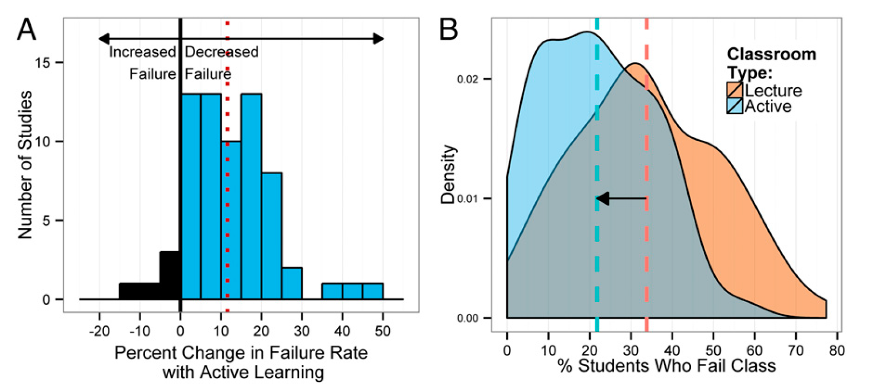
Changes in Failure Rate Lecture vs Active Learning
(A) The mean change (12%) is indicated by the dashed vertical line.
(B) Kernel density plots of failure rates under active learning and under lecturing. The mean failure rates under each classroom type (21.8% and 33.8%) are shown by dashed
vertical lines.
Freeman et al., 2014

Slide 36
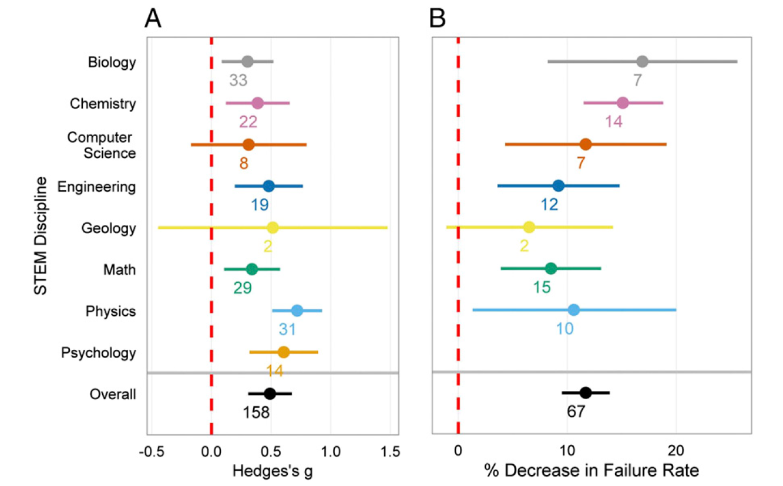
Changes in Assessment Performance and Failure Rate Lecture vs Active Learning
(A) Data on examination scores, concept inventories or other assessments
Freeman et al., 2014

Slide 37
Active Learning Increases Student Performance in Science, Engineering, and Mathematics
Active learning confers disproportionate benefits for STEM students from disadvantaged backgrounds and for female students in male-dominated fields;
The results raise questions about the continued use of traditional lecturing as a control in research studies, and support active learning as the preferred, empirically validated teaching practice in regular classrooms.
Freeman et al, 2014

Slide 38
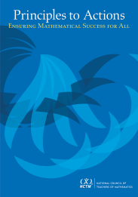
Effective
Mathematics Teaching Practices
Establish mathematics goals to focus learning.
Implement tasks that promote reasoning and problem solving.
Use and connect mathematical representations.
Facilitate meaningful mathematical discourse.
Pose purposeful questions.
Build procedural fluency from conceptual understanding.
Support productive struggle in learning mathematics.
Elicit and use evidence of student thinking.

Slide 39
A Common Vision for Undergraduate Mathematical Sciences in 2025
“The status quo is unacceptable.”
Calls on the community to:
Update curricula
Articulate clear pathways between curricula driven by changes in K-12 and the first courses students take in college
Scale up the use of evidence-based pedagogical methods
Remove barriers at critical transition points
Establish stronger connections with other disciplines

Slide 40
College and Career Readiness

Slide 41
Systemic Improvement in High School Mathematics
Increase emphasis on modeling, statistics and discrete mathematics.
Increase emphasis on conceptual understanding, including ratios and proportional relationships.
Ensure that the “rush to calculus” does not narrow the curriculum and decrease students’ mathematical preparation.
Clarify the mathematics required for college and career readiness based on research.
Provide adequate time for students to develop proficiency in the Standards for Mathematical Practice/Process Skills.

Slide 42
Systemic Improvement in High School Mathematics
Implement the 8 effective teaching practices in all high school courses
Move to an integrated high school mathematics courses

Slide 43
Thank You! Diane Briars dbriars@nctm.org

